Slide 1
Know Your Hardware: CPU Memory Hierarchy
Alexander Titov

Slide 2
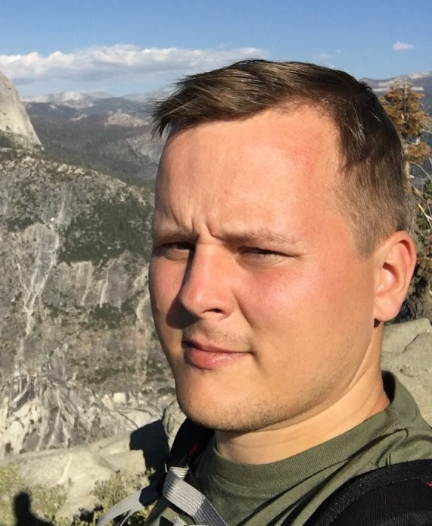


About me
Alexander Titov
CPU Hardware Architect
10 years of C++ experience (CPU simulation)
Teaching Computer Architecture and Design
alexander.titov@atitov.com
alexander-titov-cpu

Slide 3
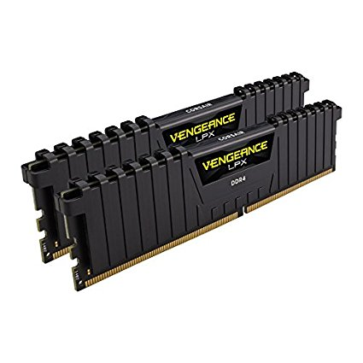
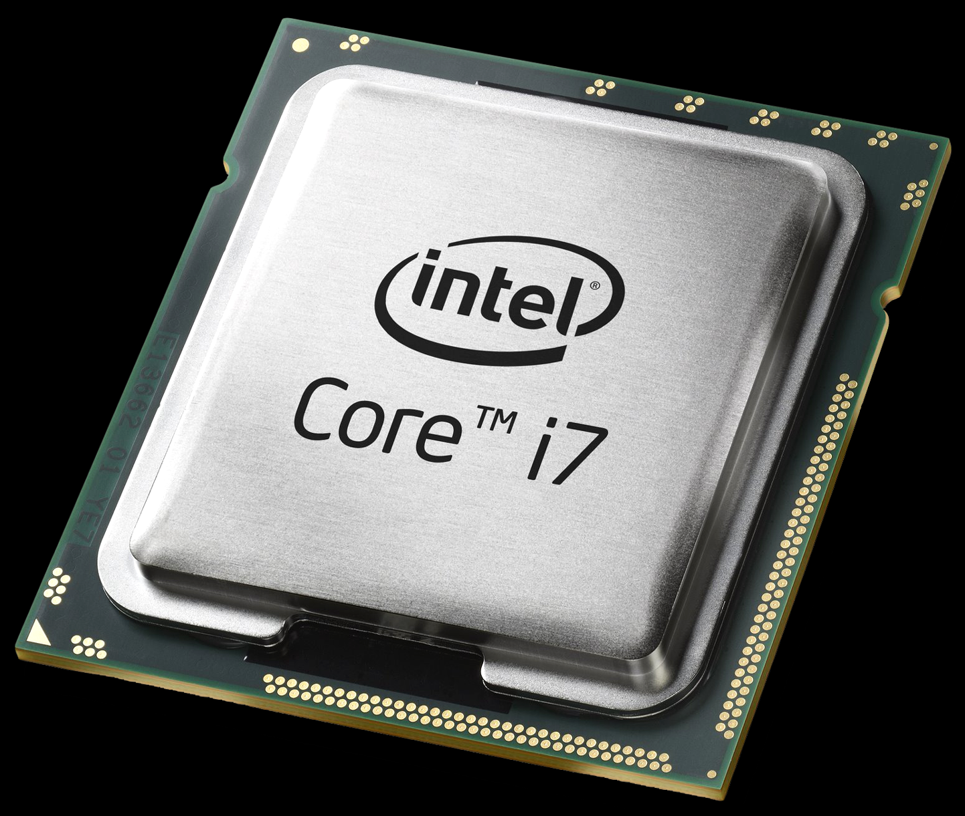
How CPU Works?
Outside World
Outside Memory
CPU

Slide 4
How CPU Works?
?
Simplified CPU actions:
2
3
a[0] = b[0] + 1
a[0] =
what next?
what to do?
010100…0101
from MEM
Read instruction
Decode it
Read inputs
Execute instruction
Write result
Read next instruction
Decode it
Read inputs
from MEM
to MEM
Outside Memory
CPU
Conclusion: CPU works a lot with Outside Memory

Slide 5
Is Outside Memory Fast?
Outside Memory
CPU
CPU

Slide 6
Is Outside Memory Fast?
– No
4x
~100 ns
~0.5 ns
Outside Memory
CPU
Memory is very slow.
CPU would wait 99% of the time for Memory response.

Slide 7
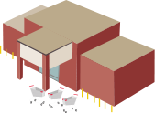

Cache Hierarchy
~30 ns
~100 ns
~10 ns
~0.5 ns
~3 ns
Cache
3rd
level
Cache
2nd
level
Cache
1st level
32 KB
Outside Memory
256 KB – 1 MB
CPU
10 – 30 MB
10 GB – 1 TB

Slide 8
Cache Hierarchy In Action
~30 ns
~100 ns
~10 ns
~0.5 ns
~3 ns
miss
miss
miss
32 KB
Outside Memory
256 KB – 1 MB
CPU
10 – 30 MB
10 GB – 1 TB

Slide 9
Cache Hierarchy In Action
~30 ns
~100 ns
~10 ns
~0.5 ns
~3 ns
hit
32 KB
Outside Memory
256 KB – 1 MB
CPU
10 – 30 MB
10 GB – 1 TB
Locality principle:
the same data is requested several times in a short period of time

Slide 10
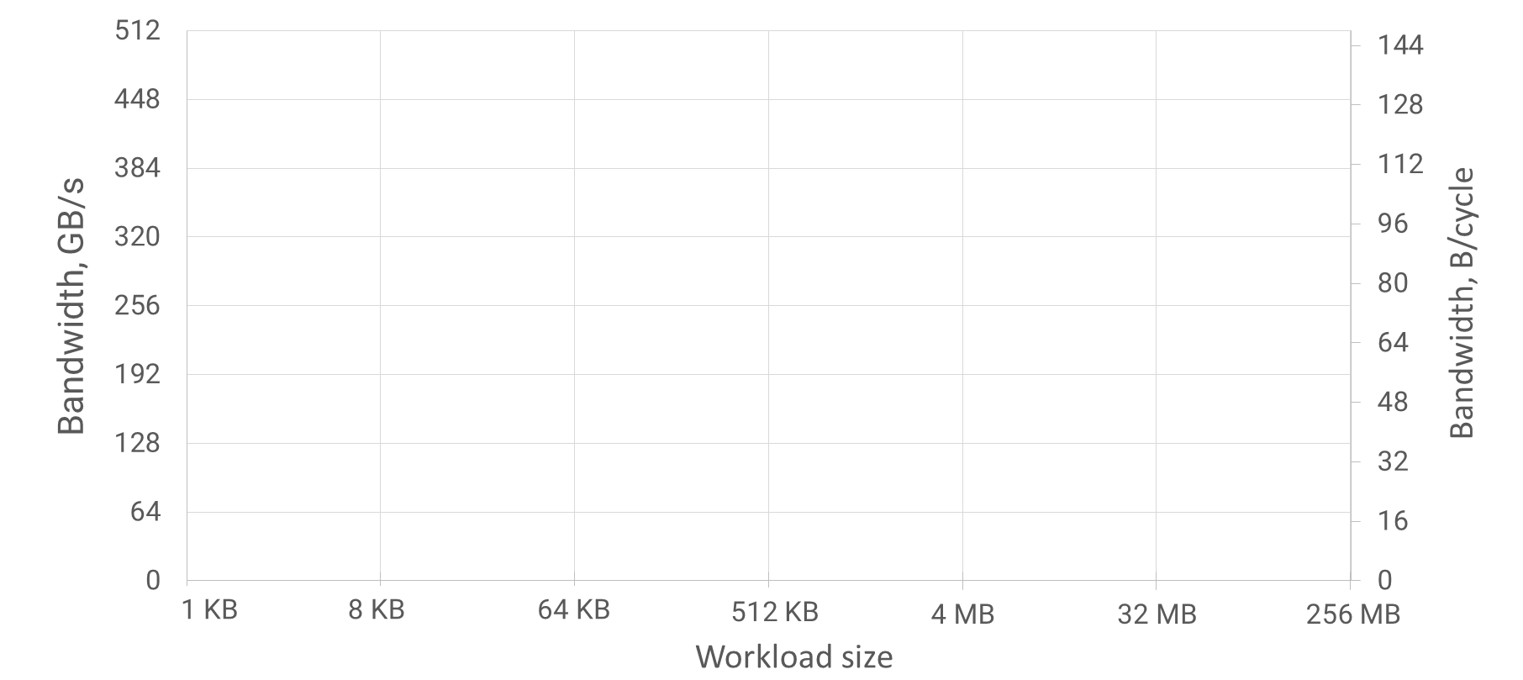
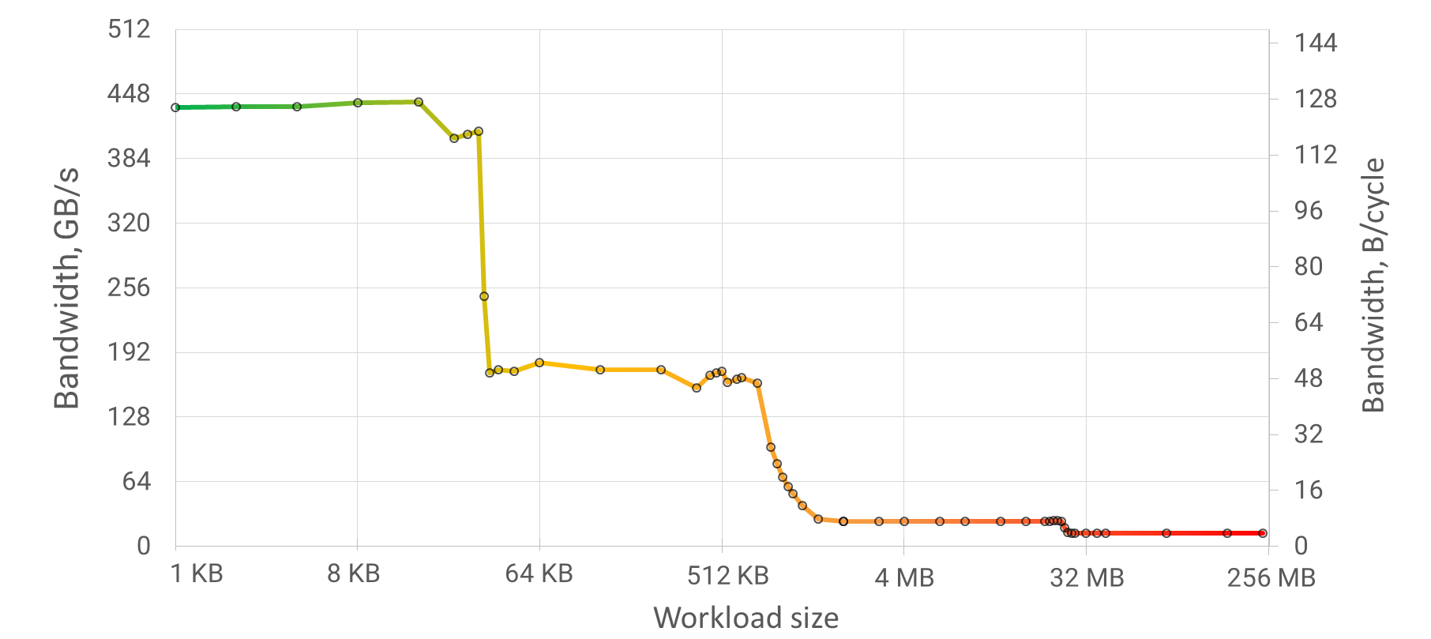
Experiment: Defining Cache Hierarchy
Intel(R) Xeon(R) Gold 6130 CPU, TDP 2.10GHz, Turbo 3.77Ghz
32 KB
1 MB
22 MB
L1 Cache
32 KB
L2 Cache
1MB
L3 Cache
22MB
Outside
Memory
430 GB/s
128 B/cycle
intuition
170 GB/s
50 B/cycle
25 GB/s
7 B/cycle
13 GB/s
3 B/cycle

Slide 11
Divide and Conquer
Split large workload in parts that fit in the cache
→ improve locality
cache size
Large workload
Split workload

Slide 12
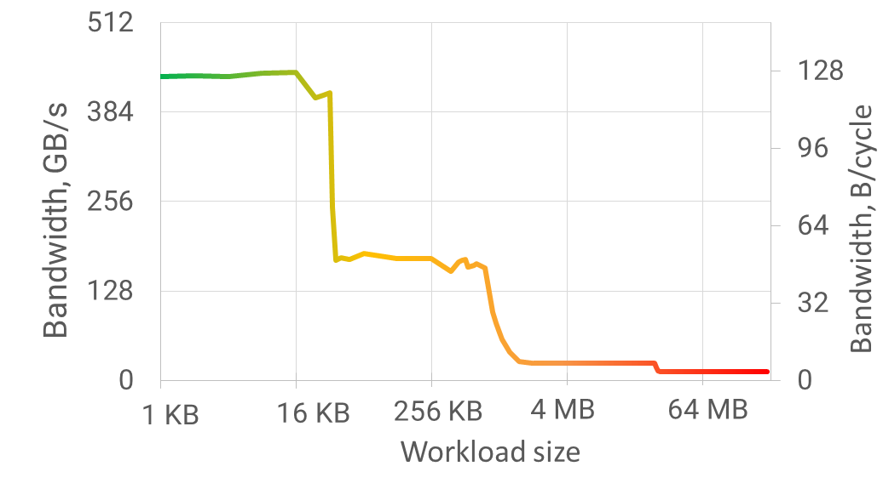
Divide and Conquer
Split large workload in parts that fit in the cache
→ improve locality
Example:
64 MB x 1000 times
→ 4096 parts x (16 KB x 1000 times)
cache size
30x
speedup
Large workload
Split workload

Slide 13
What is inside CPU?

Slide 14
Many thanks!
Questions welcome :)
Alexander Titov
alexander.titov@atitov.com
alexander-titov-cpu

